Slide 1
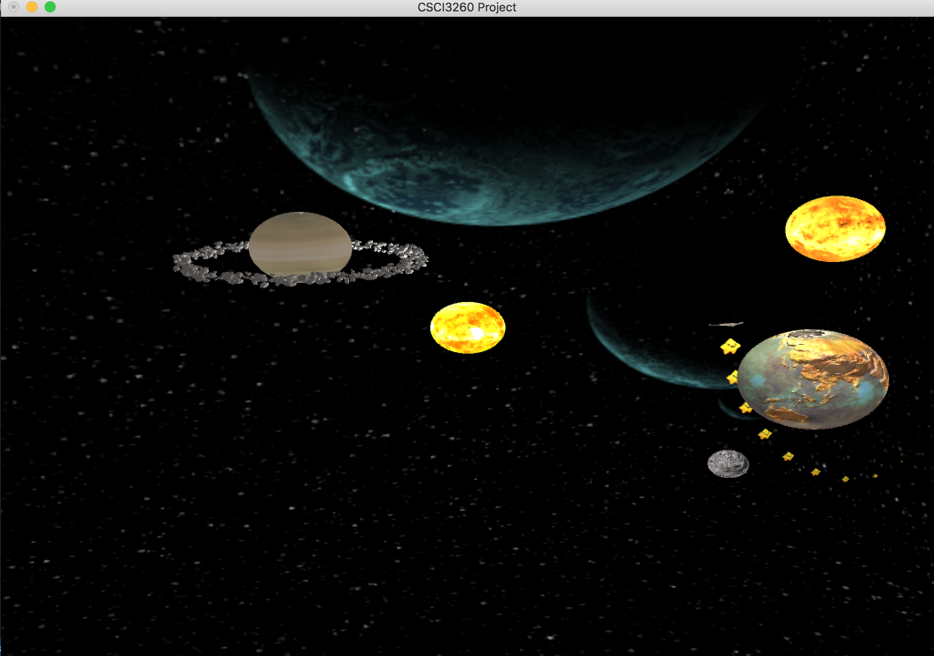
Space OdySSEY – CSCI3260

Slide 2
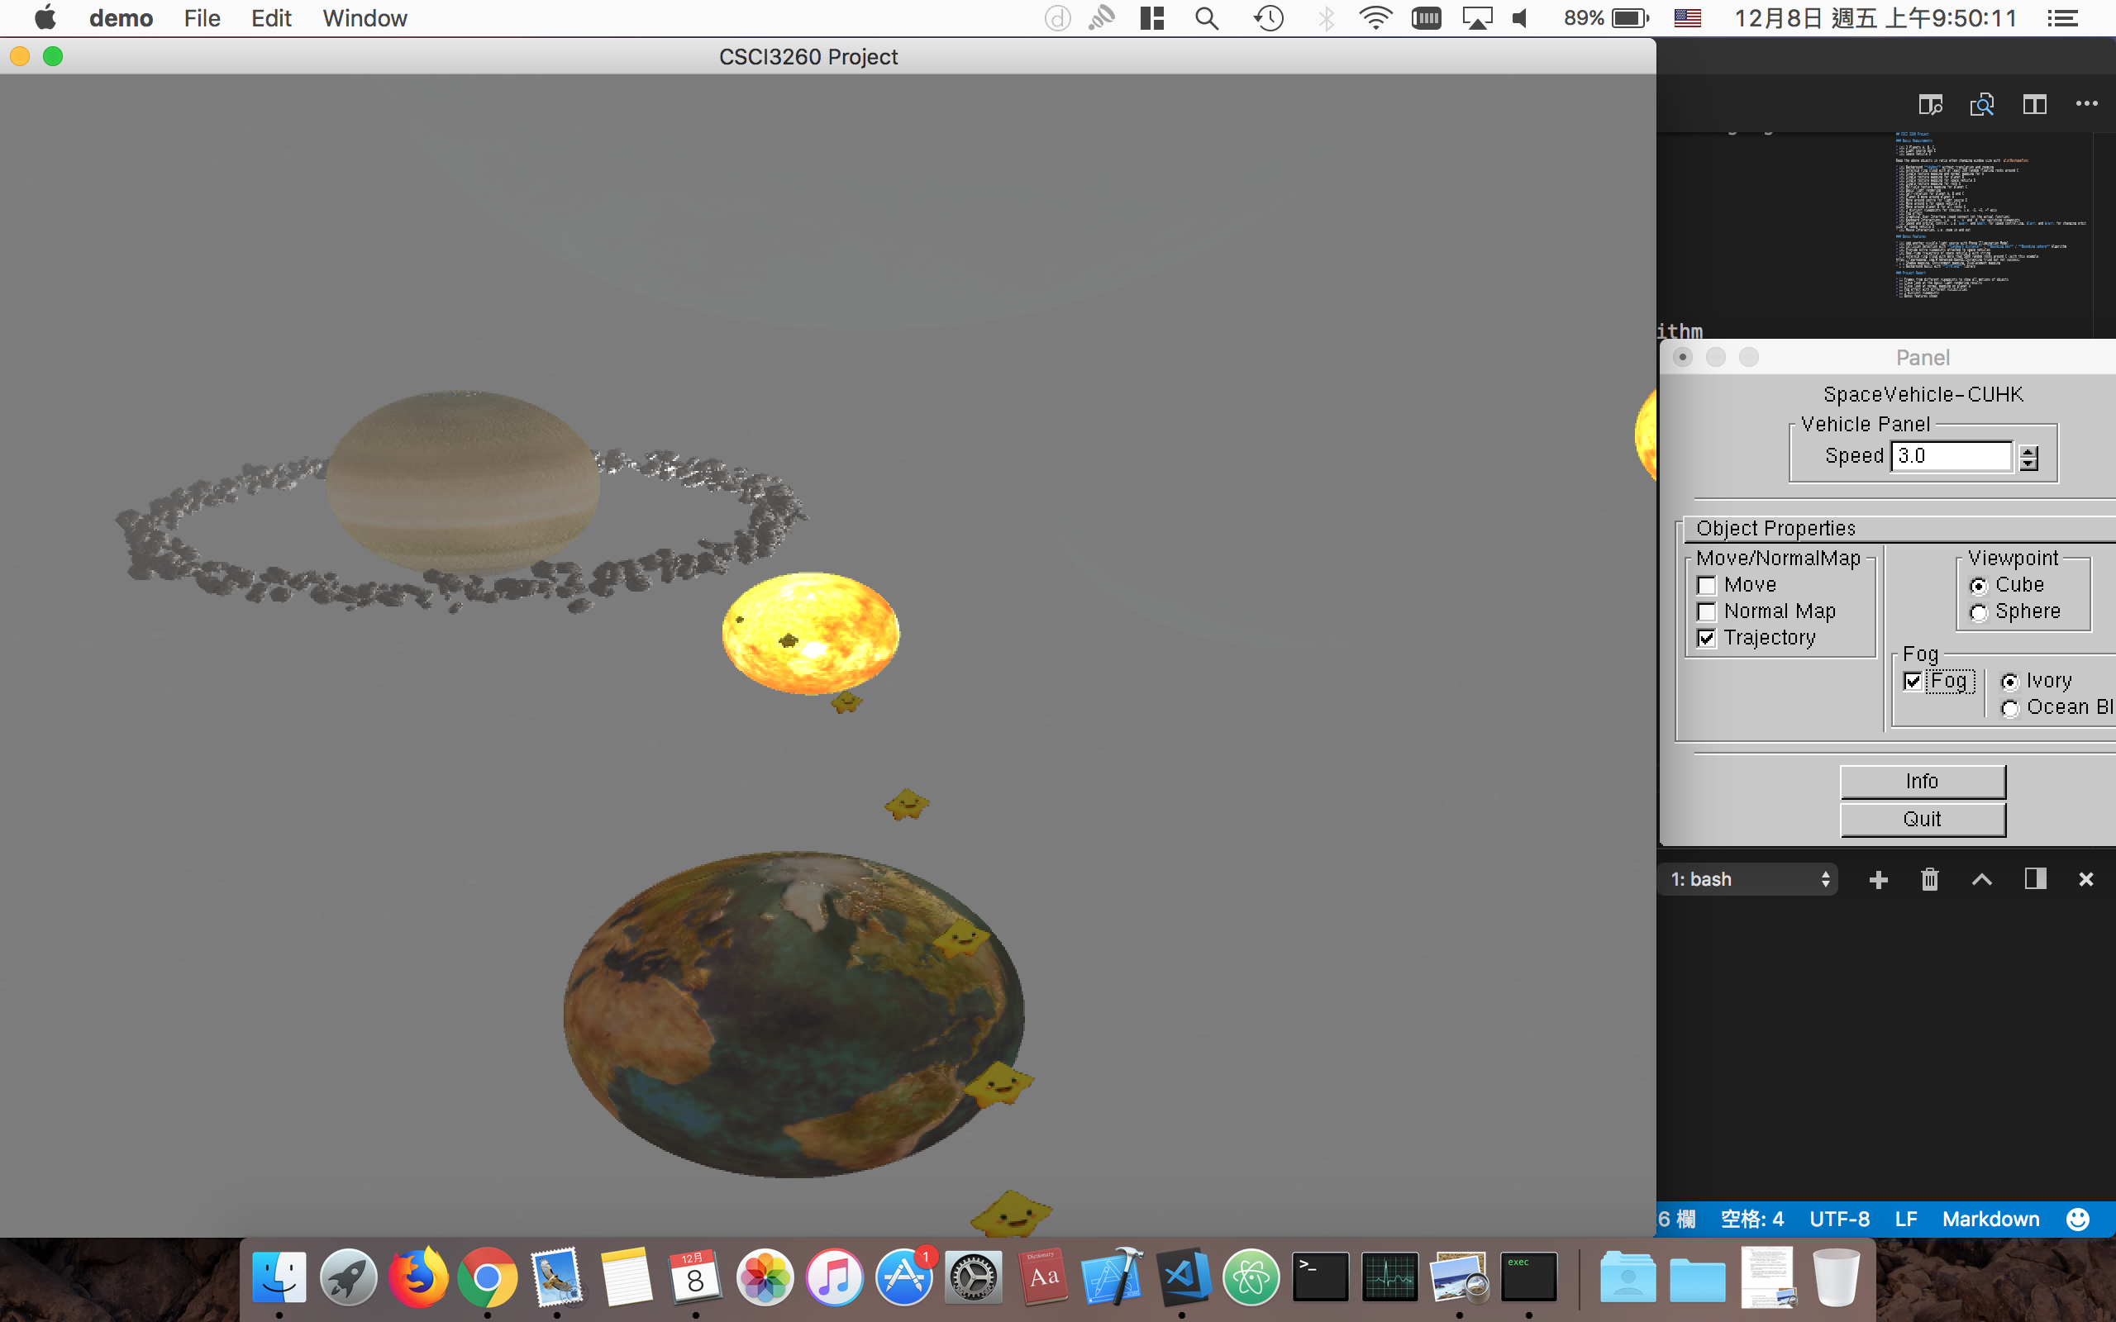
Default run with fog effect

Slide 3
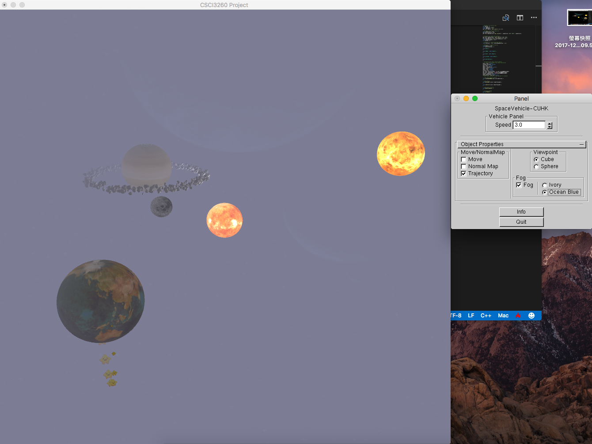
fog effect with blue colour

Slide 4
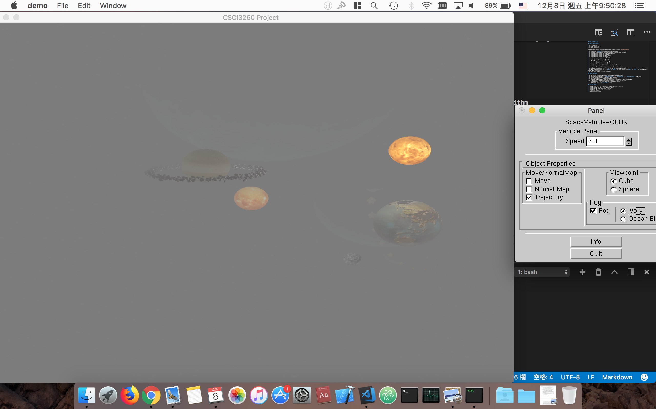
fog effect with Longer Distance

Slide 5
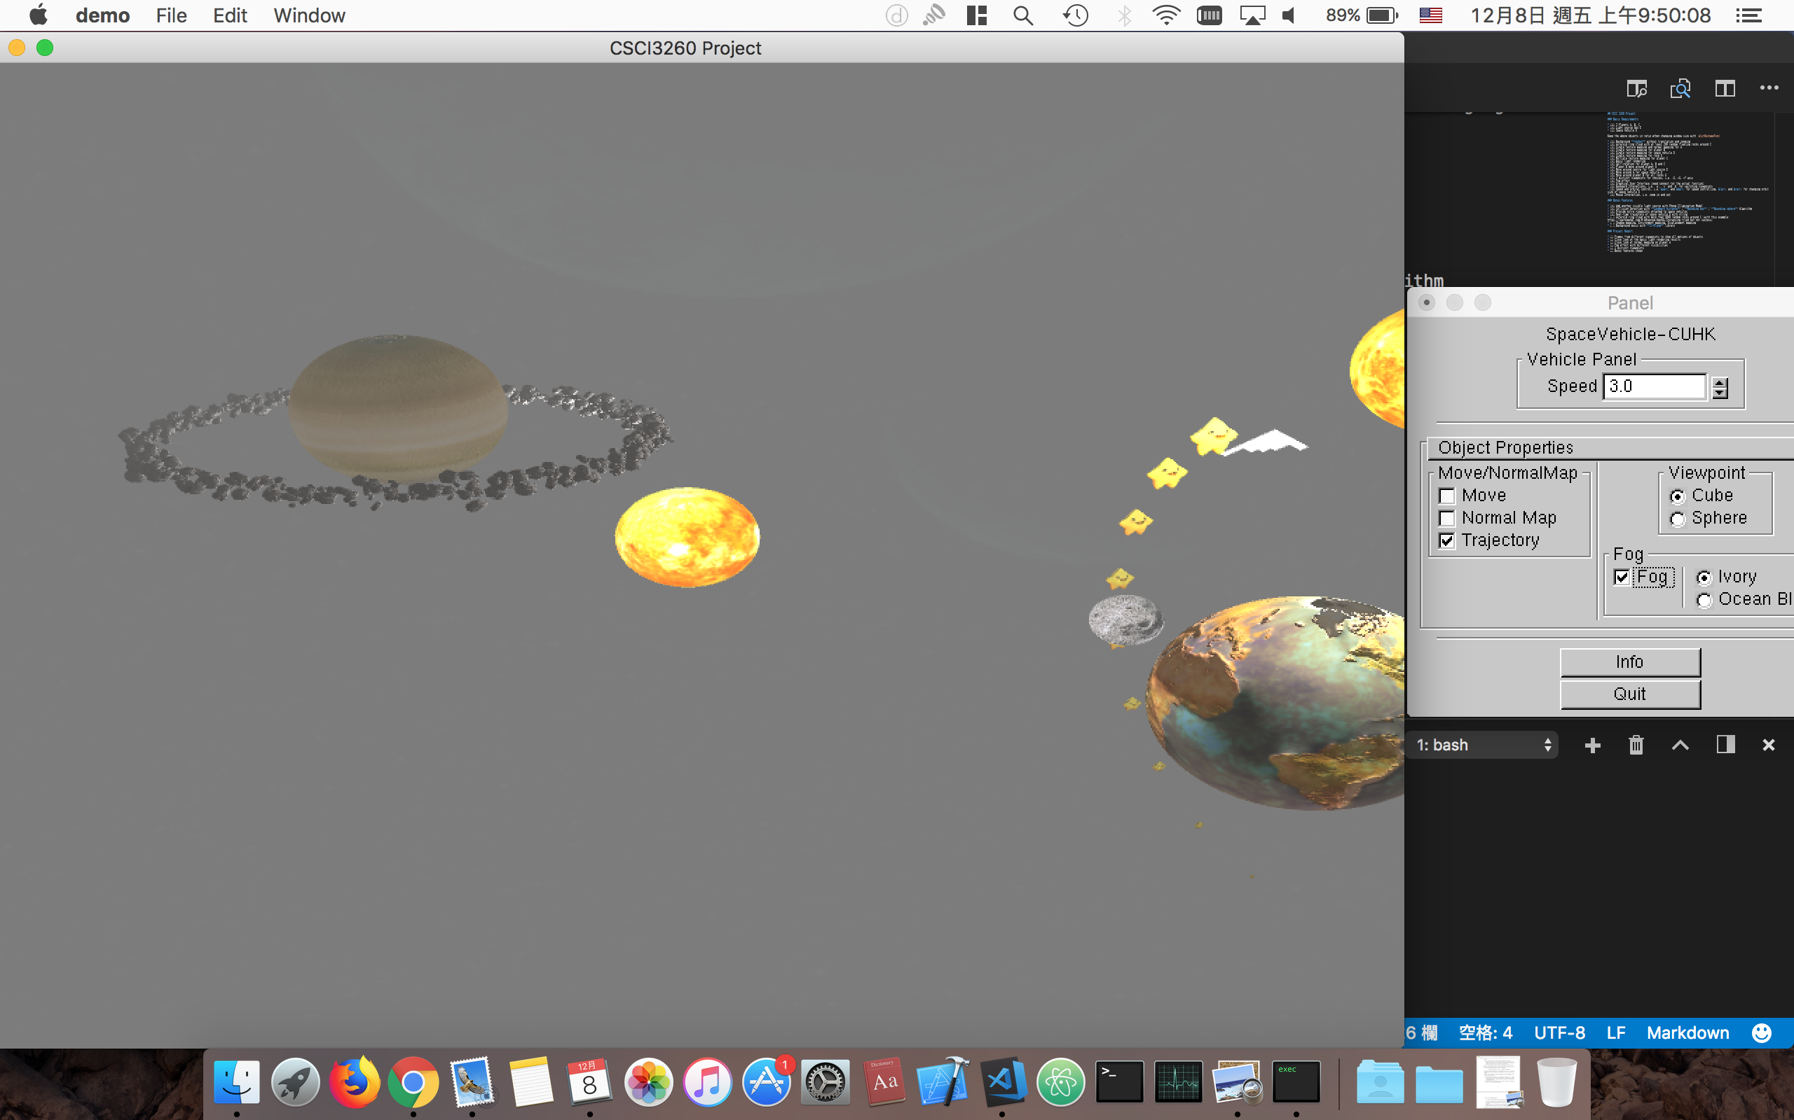
fog effect with Shorter Distance

Slide 6
fog effect with Shorter Distance
Lighting and normal mapping

Slide 7
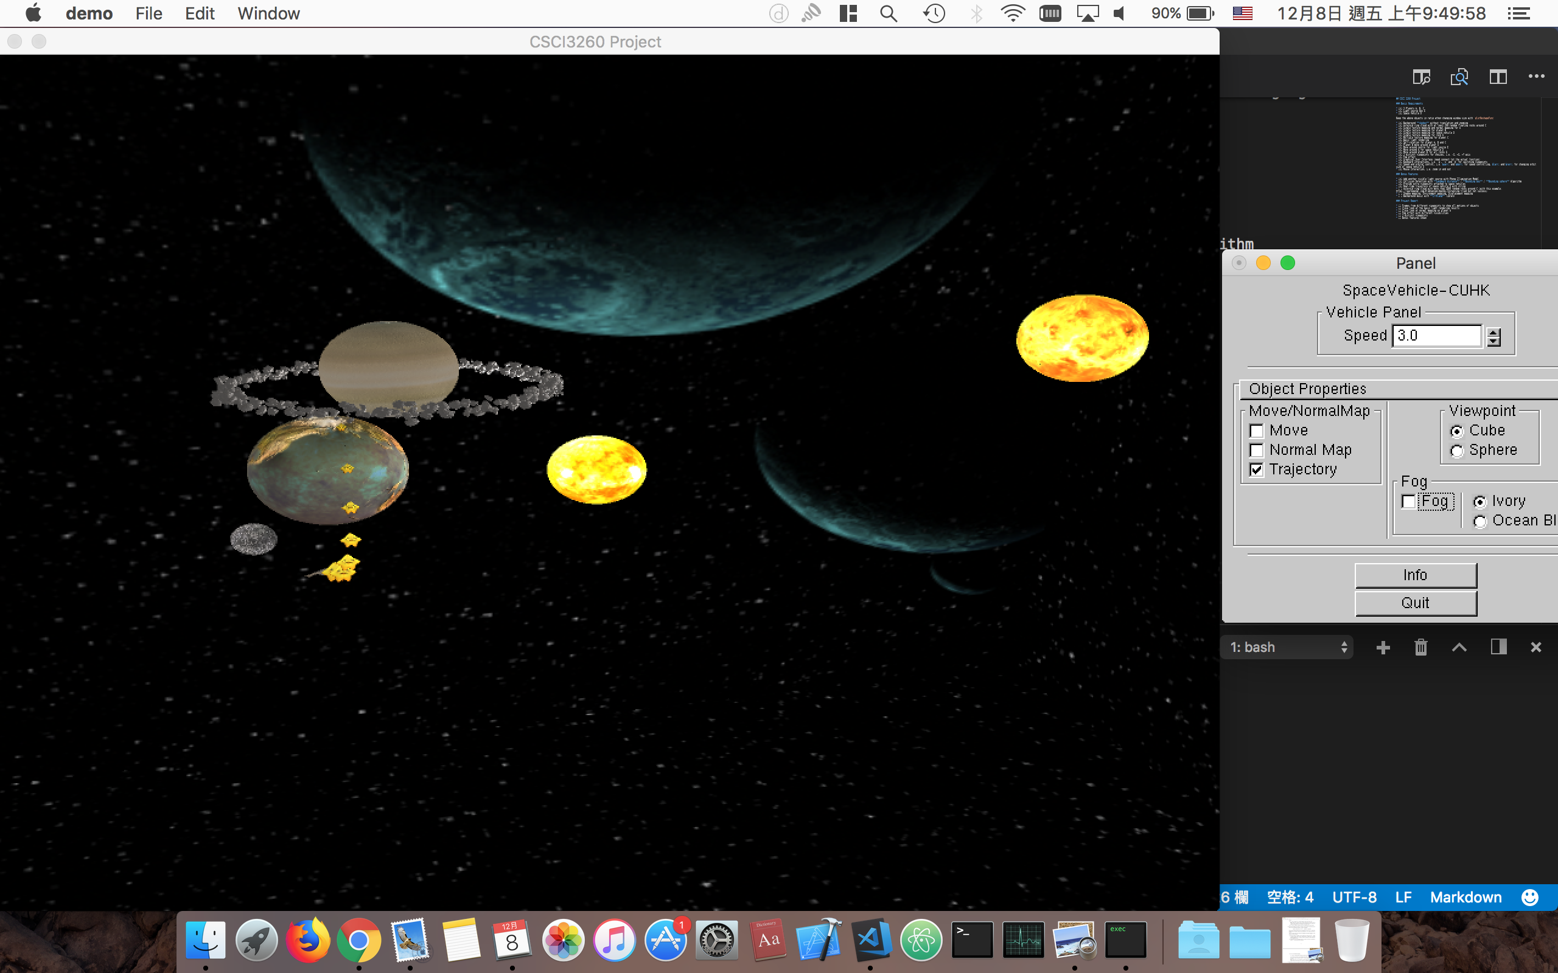
Normal view

Slide 8
Normal view
Light Source Object with larger ambient
Diffuse Lighting
Very weak specular light in our setting since planets will not have specular light too much

Slide 9
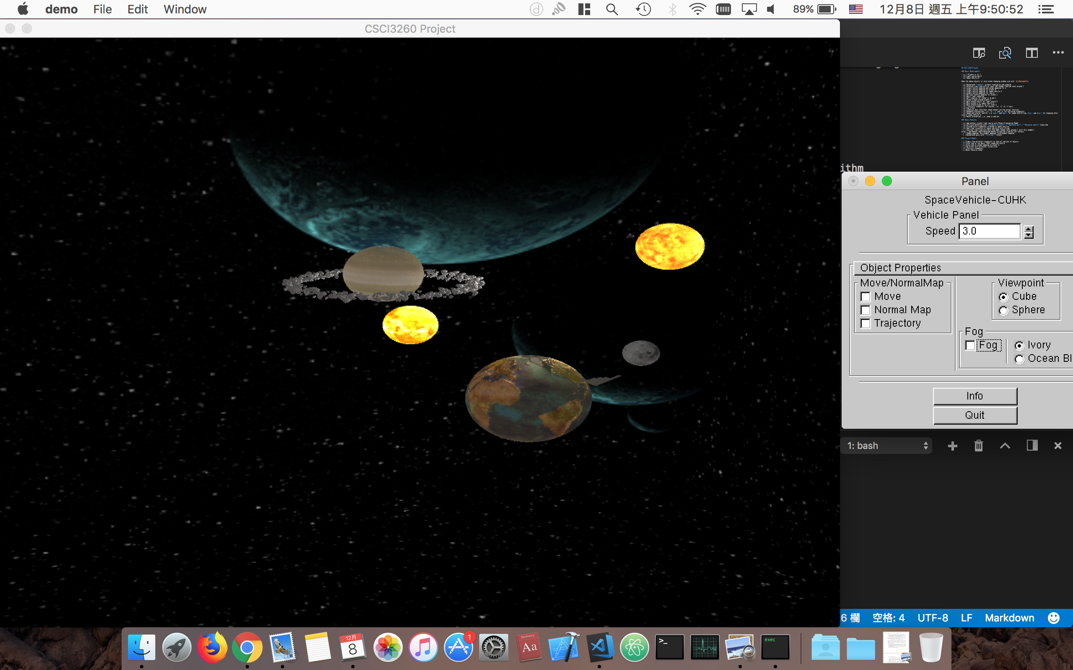
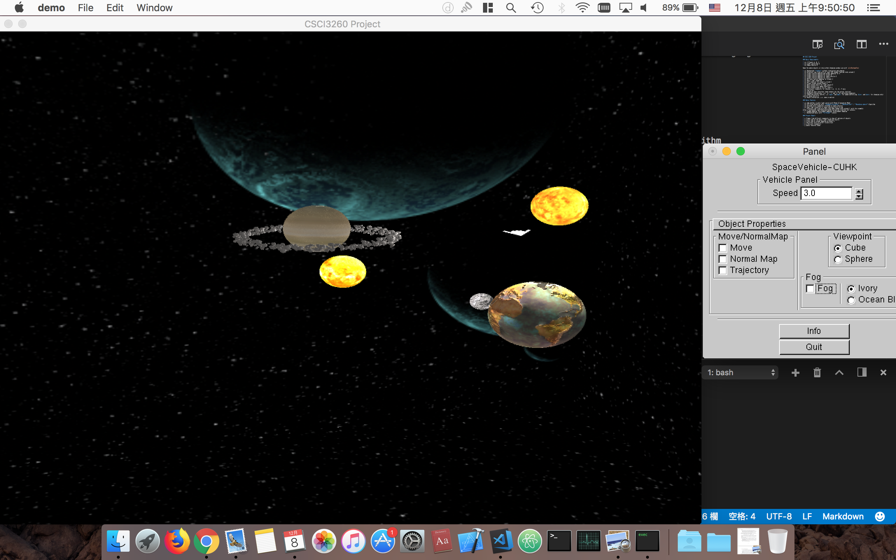
highlight on normal mapping

Slide 10
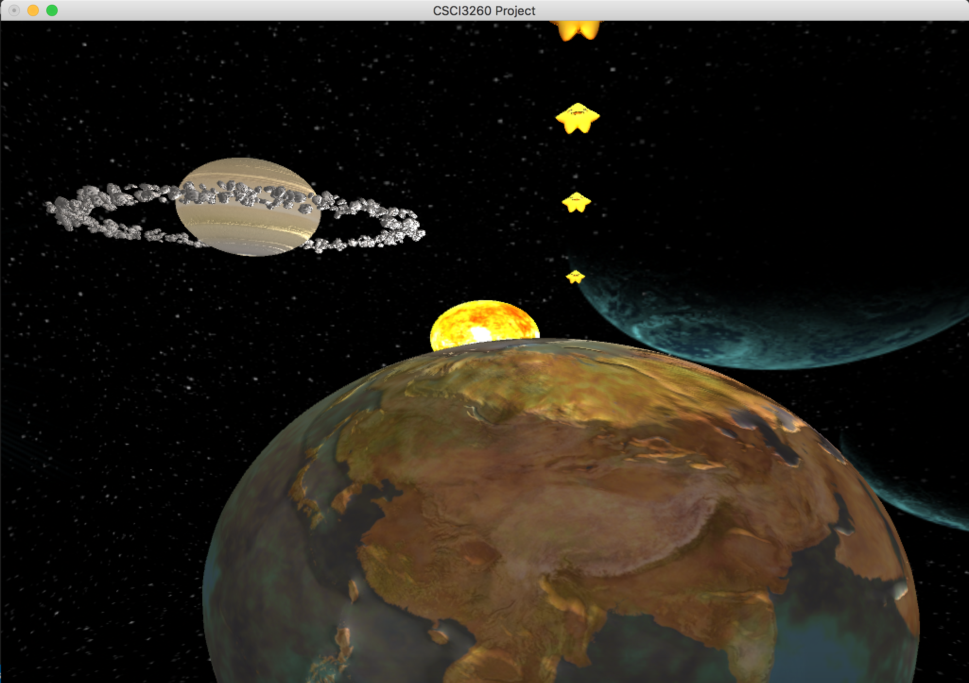
highlight on normal mapping

Slide 11
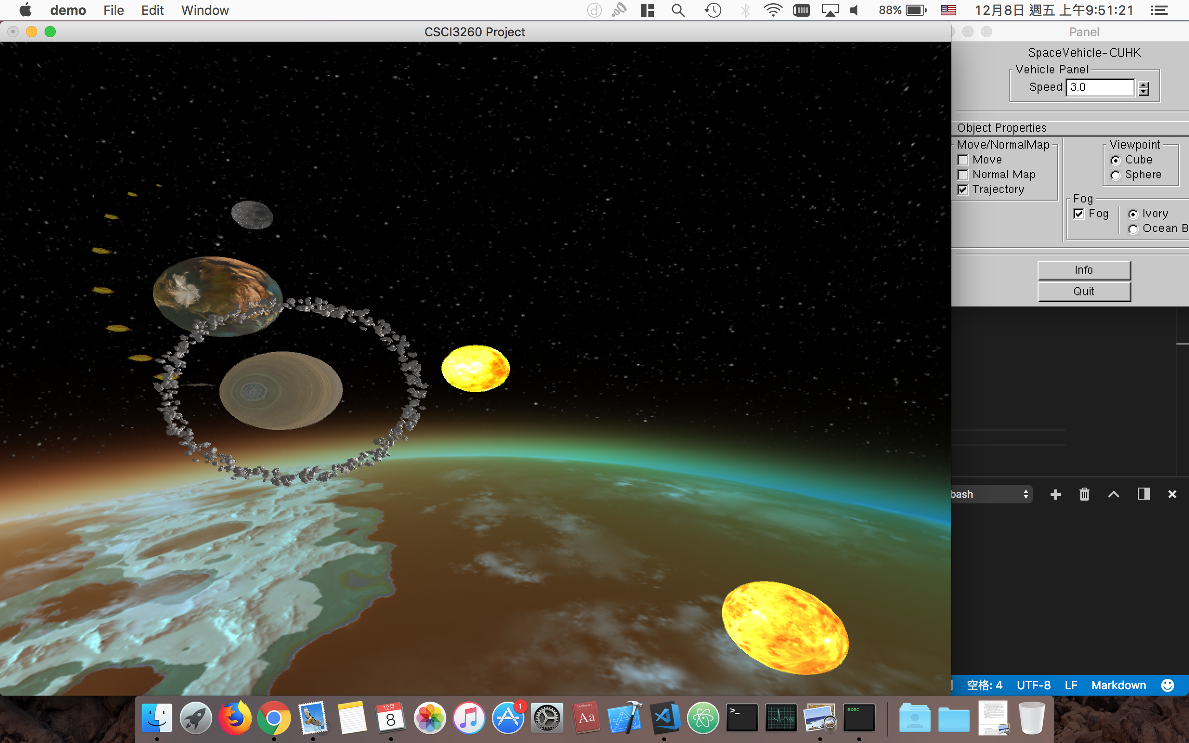
Top view

Slide 12
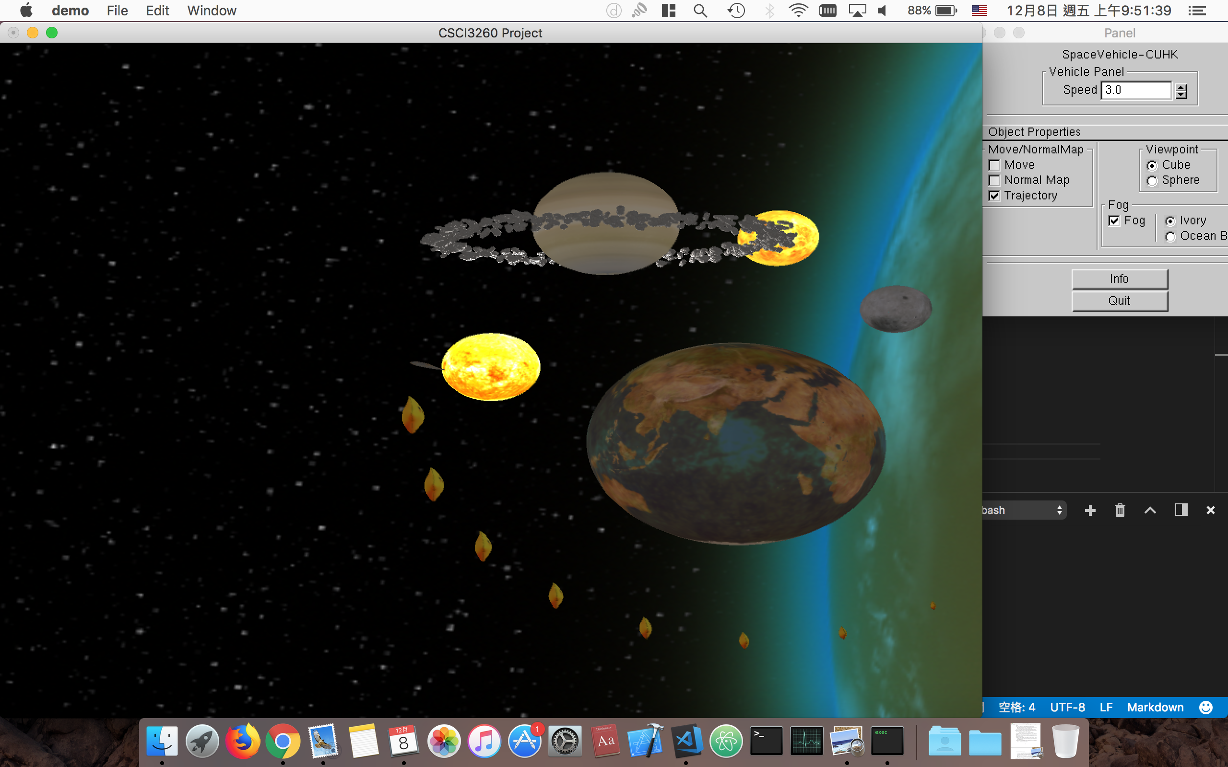
left view

Slide 13
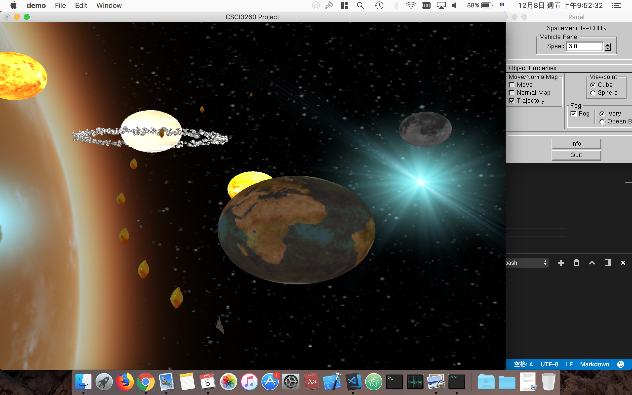
Right view

Slide 14
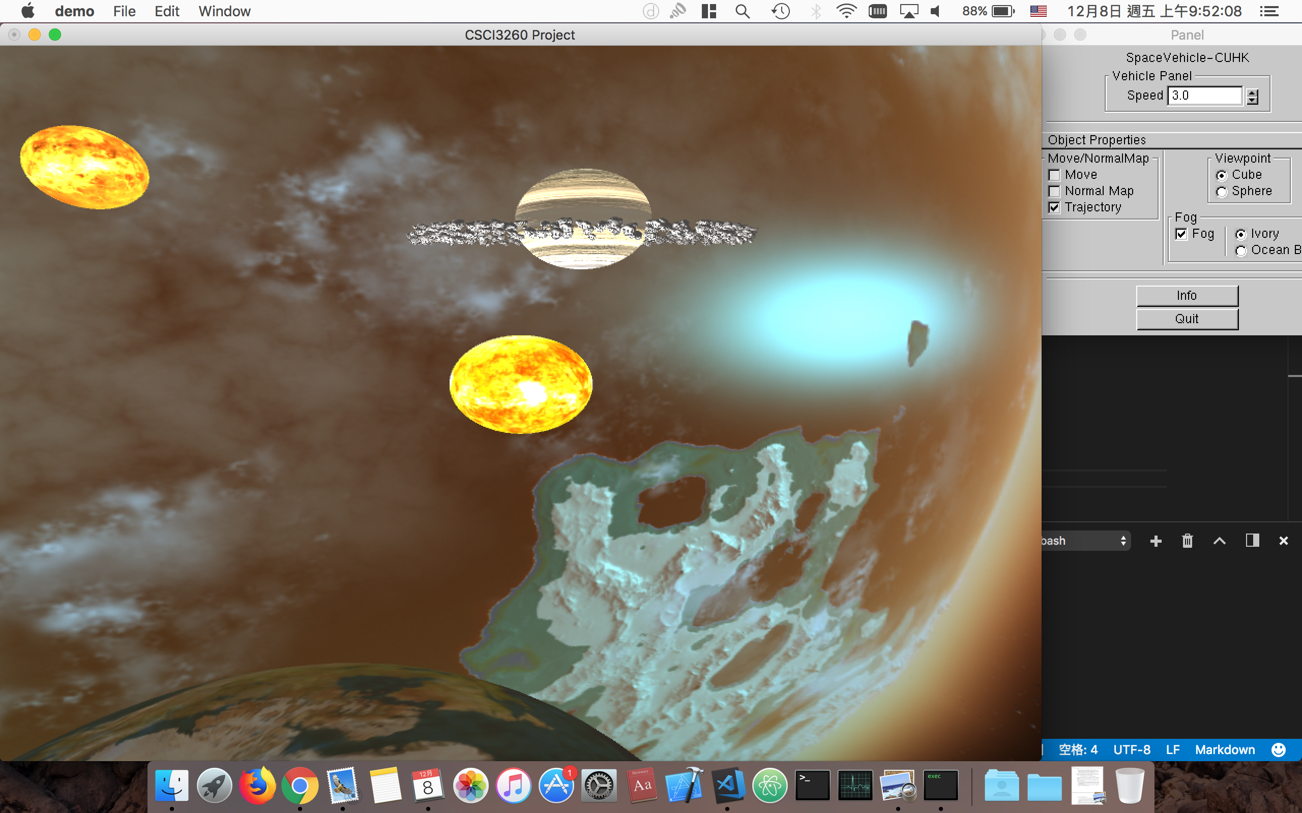
View from space vehicle

Slide 15
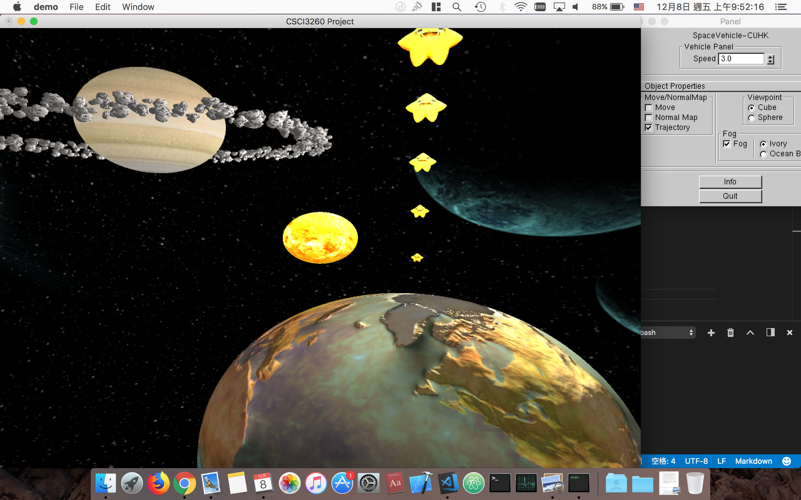
View from space vehicle

Slide 16
View from space vehicle
Shadow by star

Slide 17
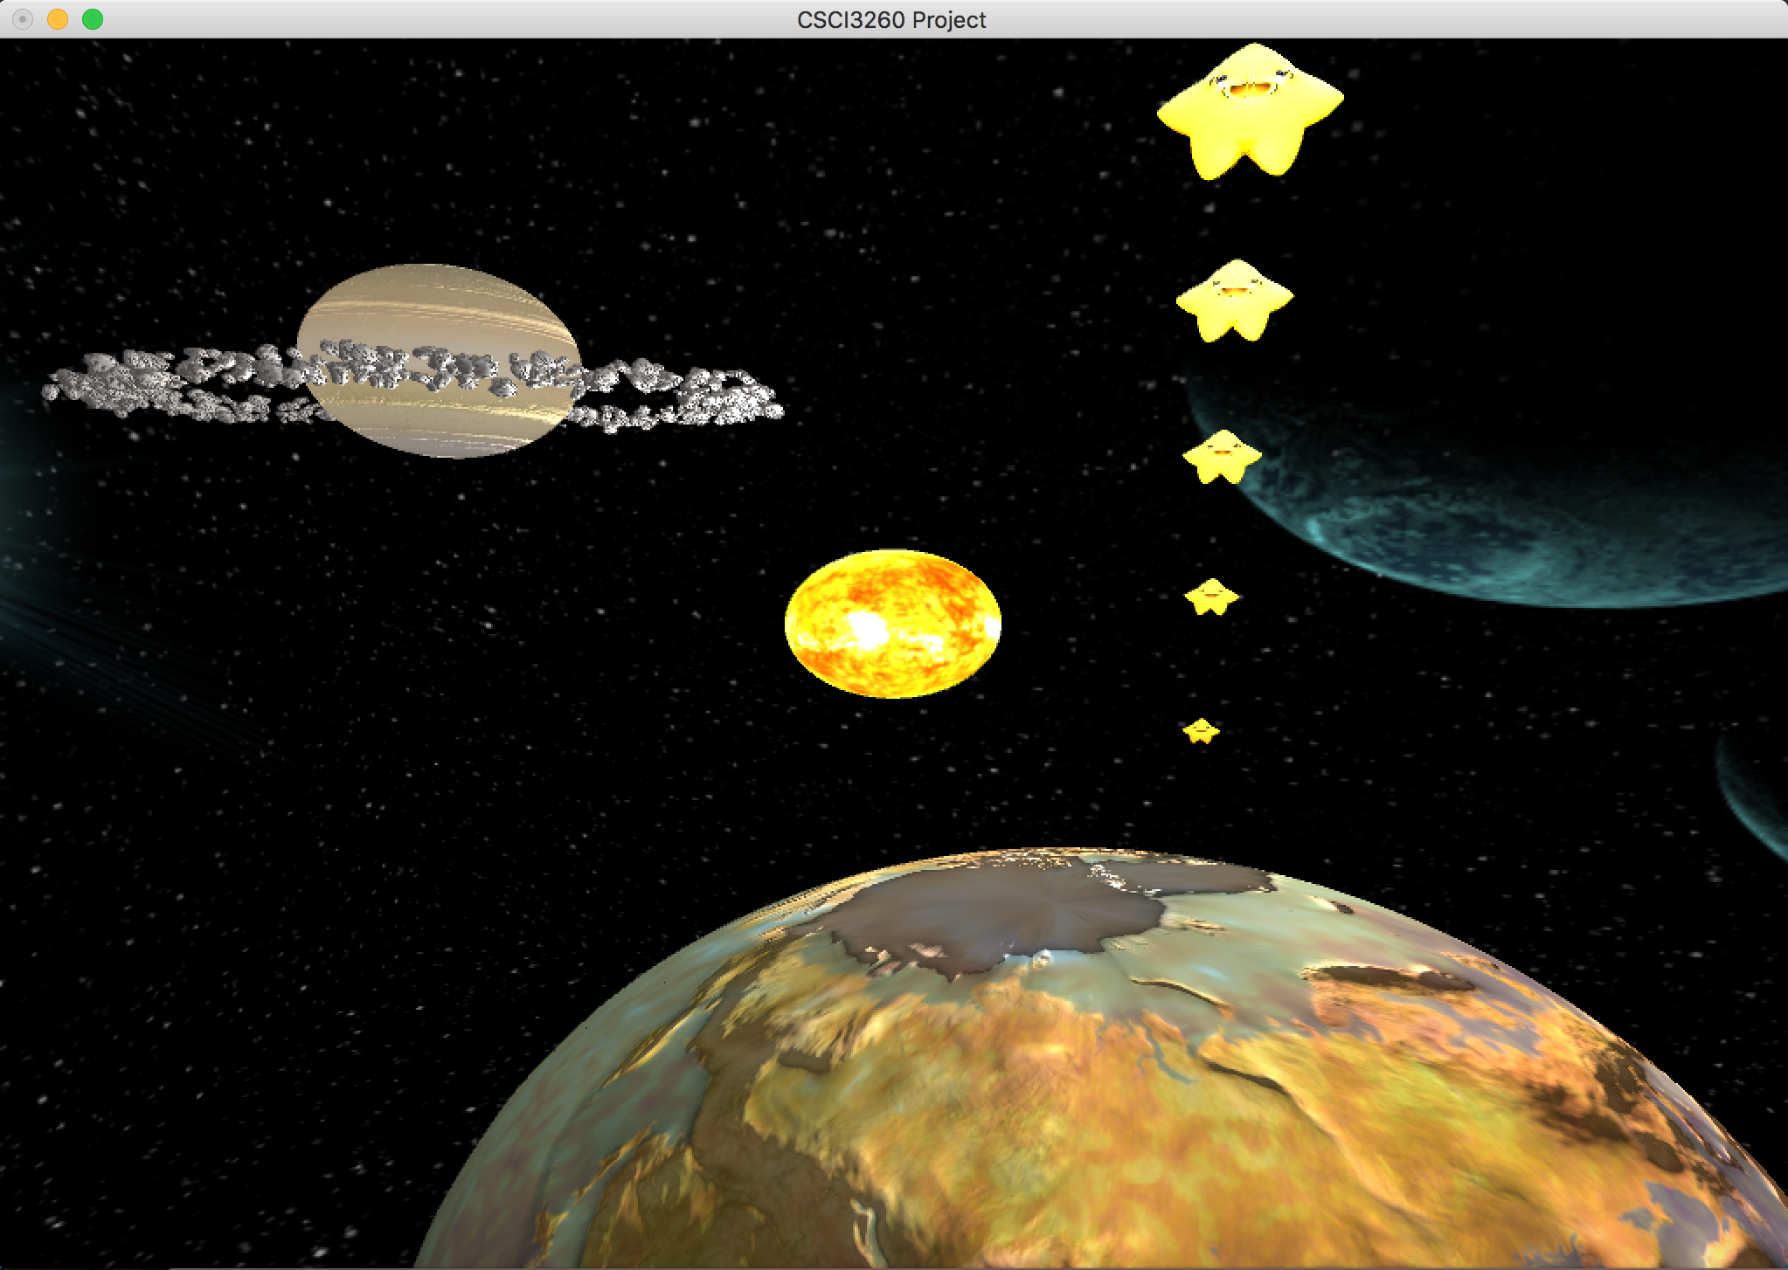
View from space vehicle

Slide 18
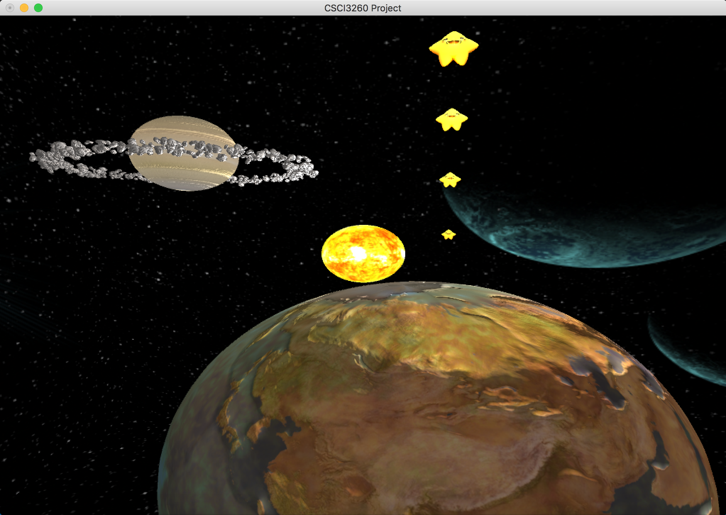
View from space vehicle

